Slide 1

Mental Health Chatbot open up with me , I’ll don’t judge

Slide 2
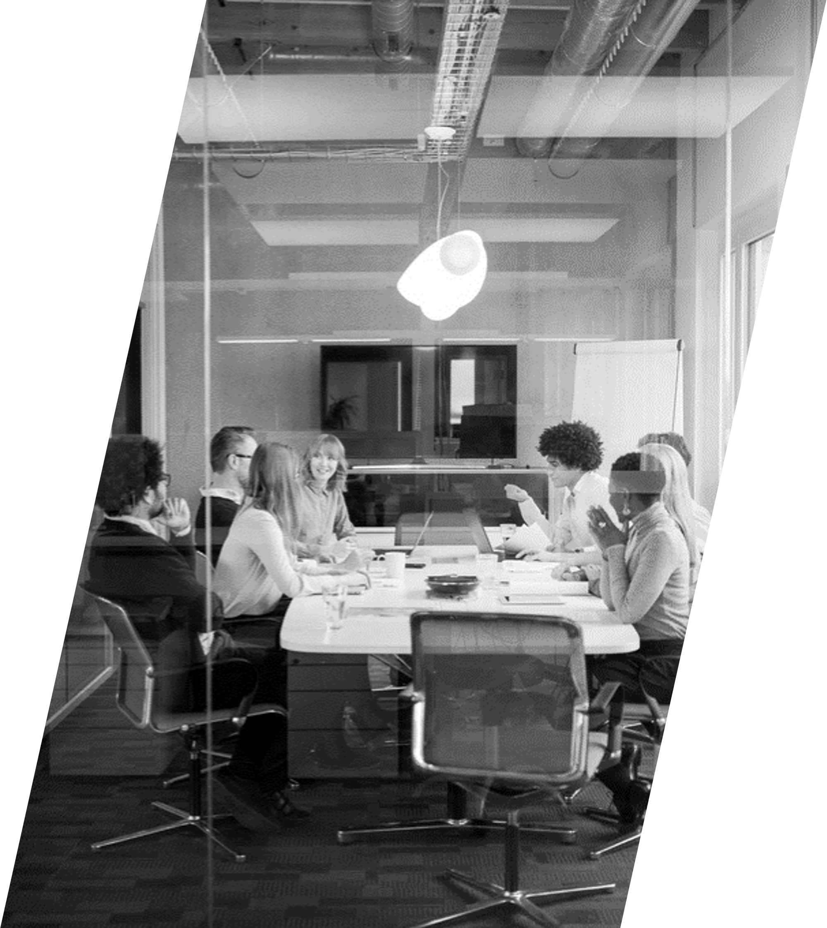
Introduction
This chatbot is designed to provide mental health support through AI-driven conversations."
"It helps users by offering motivation, relaxation tips, and mental health awareness."

Slide 3

Why we created this chatbot
"Many people hesitate to seek professional help due to stigma or
lack of awareness."
"Our chatbot provides an easy, non-judgmental platform
for mental health support."

Slide 4
Features
🔹 Emotion-Based Responses – Provides support based on user input.
🔹 Motivational Quotes – Encourages positivity.
🔹 Relaxation Exercises – Suggests meditation, breathing techniques, etc.
🔹 24/7 Availability – Can be accessed anytime.
🔹 Anonymous Conversations – No personal details required.
.

Slide 5
Technologies used
📌 Programming Language: Python 📌 Libraries: TensorFlow, NLTK, NumPy 📌 Data Handling: JSON for storing predefined responses 📌 Platform: Command-Line Interface (CLI) 📌 Development Tool: VS Code
.

Slide 6
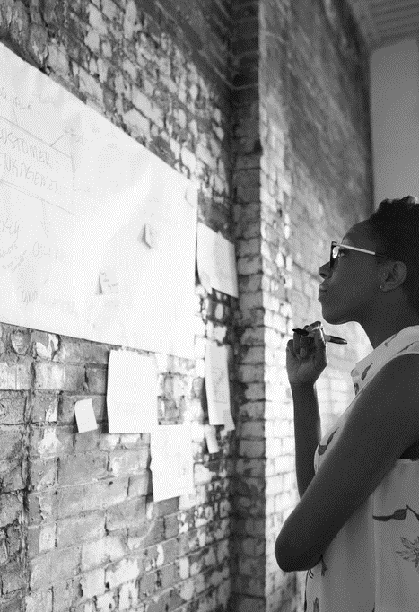
How it works
1️⃣ User enters a message.
2️⃣ Chatbot processes the input using NLP techniques.
3️⃣ Predicts user intent using a trained deep learning model.
4️⃣ Selects the best response from the dataset (intents.json).
5️⃣ Replies appropriately.

Slide 7
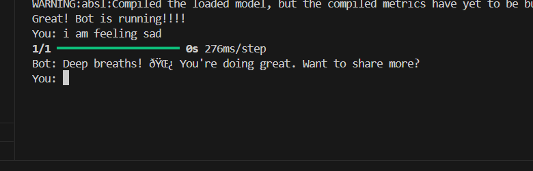
Project Demo
.

Slide 8
Challenges faced and solution
✅ Challenge: Handling diverse user inputs
Solution: Improved training data & response categories. ✅ Challenge: Understanding emotions
Solution: Enhanced intent classification. ✅ Challenge: Making responses more interactive
Solution: Added more personalized responses.
.

Slide 9

Future enhancements
🔹 Voice Input & Output – Enable speech-based conversations. 🔹 Sentiment Analysis – Detect user emotions more accurately. 🔹 Integration with Therapists – Connect users to professionals if needed. 🔹 Web-Based Interface – Move from CLI to a user-friendly web or mobile app.

Slide 10

Conclusion
Our chatbot provides a simple yet effective way to support mental well-being.“
"It encourages positive habits, self-care, and mental health awareness.“
"Future improvements can make it even more interactive and accessible."

Slide 11

Contacts
Chetna Bharti (chetna844126@gmail.com)
B. Sai Rakesh (sairakesh6309@gmail.com)
Anuradha Tomar(anuradhatomar0705@gmail.com)
Github Repository link (https://github.com/Chetna3110/My_projects-/tree/main/chatBot_project)

Slide 12

THANK YOU
by
Chetna Bharti
Anuradha Tomar
B. Sai Rakesh

